Slide 1
Digital Communication

Slide 2
What is Communication?
The transmission of information from the sender to the recipient through some medium is called as communication.
Communication enables us to know what is happening around us.
It helps us to share our knowledge with others and also gain from other individual’s thoughts and ideas.
Communication takes place through various routes and channels and with the help of a medium.
A person can chat with his distant relative over the phone and thus the medium of communication in this case is the telephone.

Slide 3
What is Digital Communication?
Digital Communication is any message passed through digital devices.
Digital communication is any type of information sent digitally.
It is defined as the method to transfer information from one place to another using digital signals.
Digital communication is a mode of communication where the information or the thought is encoded digitally as discreet signals and electronically transferred to the recipients.
Digital communication is one of the most commonly used mode of communication in the current scenario. Organizations generally rely on this mode for all their business communications.
For most of the time keyboard in the source of digital signal such as o and 1.
But if the source is analog, first, we have to convert it into a digital signal using analog to digital converter.

Slide 4
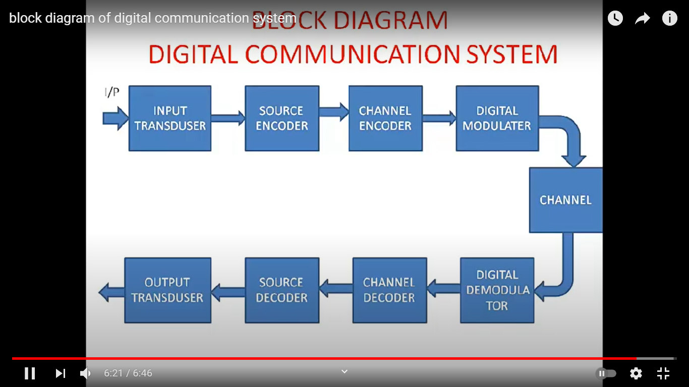
Block Diagram of Digital Communication System

Slide 5
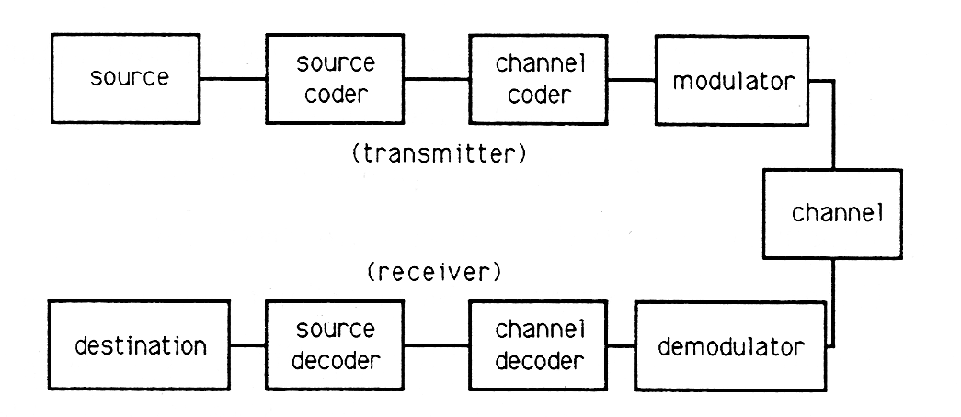

Slide 6
Advantages
It is fast and easier .
No paper is wasted.
The messages can be stored in the device for longer times, without being damaged.
Digital communication can be done over large distances through internet and other things.
It is comparatively cheaper.
It removes semantic barriers because the written data can be easily changed to different languages using software.
It provides facilities like video conferencing which save a lot of time, money and effort .

Slide 7
Disadvantages
It is unreliable as the messages cannot be recognized by signatures.
The establishment of Digital Communication causes degradation of the environment in some cases.
"Electronic waste" is an example. The vibes given out by the telephone and cell phone towers are so strong that they can kill small birds.
Many people misuse the efficiency of Digital Communication.

Slide 8
What are some examples?
Some examples of digital communication are
E-mailing
- Computers
Texting
- Cell Phones
Fax
Teleconferencing
Video conferencing

